Slide 1
Name:SOWJANYA YARAJARLA PROJECT NAME : KEYLOGGER AND SECURITY

Slide 2

PROJECT TITLE
KEYLOGGER AND SECURITY

Slide 3


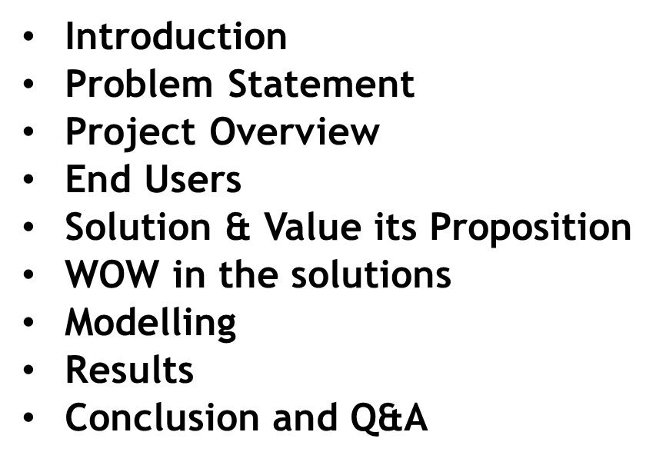



AGENDA
3/21/2024 Annual Review

Slide 4

INTRODUCTION
This capability makes them a significant security threat, raising concerns about privacy and data protection.
Effective detection and prevention measures, including the use of anti-malware software, firewalls, and strong authentication protocols, are essential to safeguard against the unauthorized use of keyloggers.
Understanding both the functionality and risks associated with keyloggers is crucial for maintaining cybersecurity and protecting sensitive information.

Slide 5

PROBLEM STATEMENT
Keyloggers can be used for legitimate purposes or maliciously. Its primary purpose is to monitor and capture the keys pressed on a keyboard.
The captured information is then often transmitted surreptitiously to remote servers controlled by malicious actors, where it can be exploited for nefarious purposes.
Objectives:
Develop detection and prevention strategies.
create a response framework.
Challenges:
Evolving Threats.
User Awareness.

Slide 6



PROJECT OVERVIEW
Develop a comprehensive understanding of keyloggers, their type , how to work , and effective security measures to prevent keylogging attacks.
Scope:.
Development Phase.
Design and implement a basic keylogger using programming languages and libraries.
Testing Phase.
Test the keylogger in a controlled environment to evaluate its functionality.
Analysis Phase.
Analyze the captured data to understand the keylogger’s effectiveness.

Slide 7
END USERS
End Users are the individuals within an organization who regularly engage with digital platforms, applications, and devices . They play a crucial role as the first line of defense against cyber threats.
Organizations : Companies and institutions that need to ensure compliance with usage policies, enhance security, and monitor employee productivity.
System Administrators: IT professionals responsible for managing and securing computing environments within an organization.
w

Slide 8

SOLUTION AND ITS VALUE PROPOSITION
Solution:
By implementing this, users can proactively protect their systems against the threat of keyloggers, mitigate potential risks, and foster a safer computing environment. The focus on advanced detection techniques, user-friendly interface, preventative measures, educational resources, ethical considerations, and continuous improvement ensures comprehensive cybersecurity defense against evolving keylogger threats.
Value proposition:
keyloggers, mitigate potential risks, and foster a safer computing environment. The focus on advanced detection techniques, user-friendly interface, preventative measures, educational resources,ethical considerations, and continuous improvement ensures comprehensive cybersecurity defense against evolving keylogger threats.
8

Slide 9
THE WOW IN OUR SOLUTION
Steps for process of keylogger and security
User input Device (keyboard)
2.Keylogger (software/Hardware)
3.Data capture Module
4. Data Storage Module
5.Data Transmission module (for remote keyloggers)
6.Attacher’s Server.
start-> Initialize Keylogger-> Capture Keystrokes->Process Keystrokes
Store Locally (local file)
Continue Capturing Keystrokes
Stop
9

Slide 10
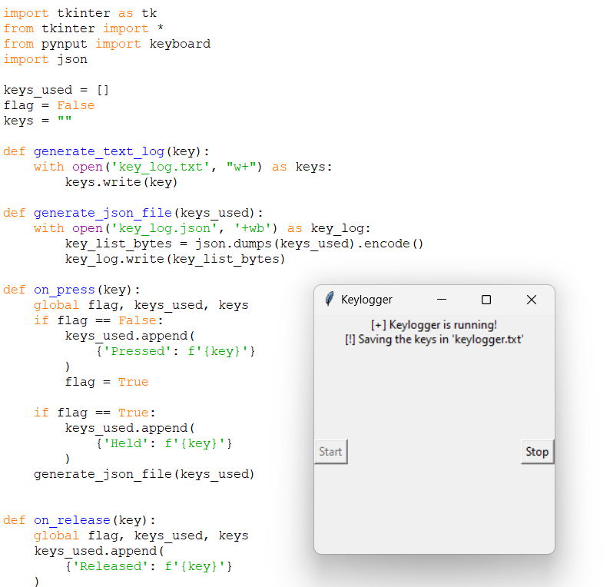
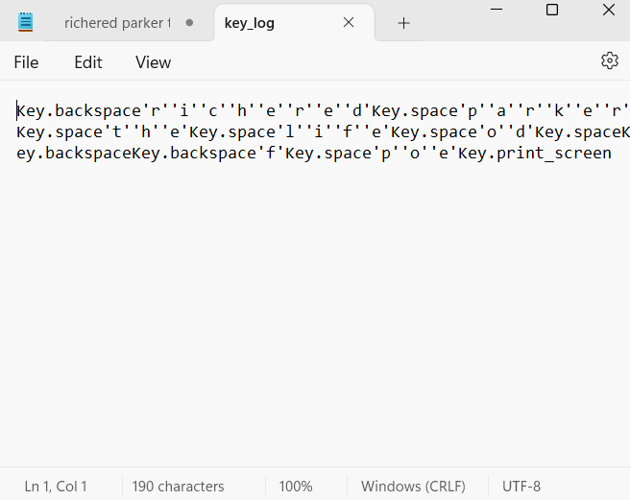
MODELLING
Code shows the module that loads the keystrokes of the keyboard the output stores in the another file named as “key log”
3/21/2024 Annual Review
10

Slide 11

RESULT
The keyloggers captures and logs keystrokes in real – time ,successfully
Displaying them in the user interface.
Performance metrics show minimal system impact and secure data transmission to the server.
Keyloggers can be used for legitimate purposes , such as employee monitoring , but they are often associated with malicious activities like identify theft, financial fraud .

Slide 12

GITHUB :
https://github.com/Sowji-yarajarla/Sowji_yarajarla.git

